Slide 1
LOAN PREDICTION SYSTEM USING MACHINE LEARNING
- S.POORNIMA GAYATHRI

Slide 2
Problem Statement
Financial institutions like banks often face challenges in assessing the risk associated with granting loans.
A loan prediction system is essential to help banks decide whether a loan applicant is likely to default or repay the loan.

Slide 3
Objective
To develop a loan prediction system that uses a classifier to classify loan applicants into two categories: loan can be approved or rejected.
The system will be deployed using a Flask web application to provide a user-friendly interface for bank staff or customers to input applicant data and receive instant predictions.

Slide 4
Dataset
By analyzing historical data on loan applications and using machine learning techniques, we can predict the likelihood of loan approval for future applicants.
Here the dataset includes various features such as cibil score, income, employment status, loan term, loan amount, assets value, and loan status.

Slide 5
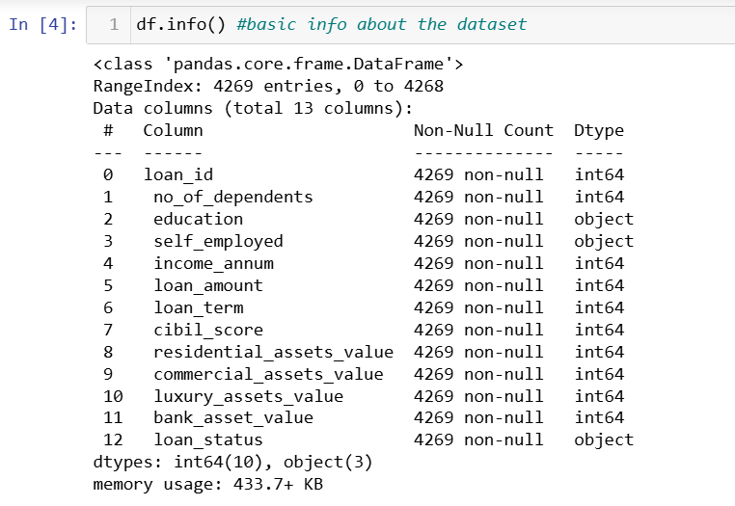

Slide 6
DATA PREPROCESSING
Data – will not always be clean.
Outliers, Missing values, Duplicate records etc in the data
Includes
Data Cleaning
Data Preparation

Slide 7
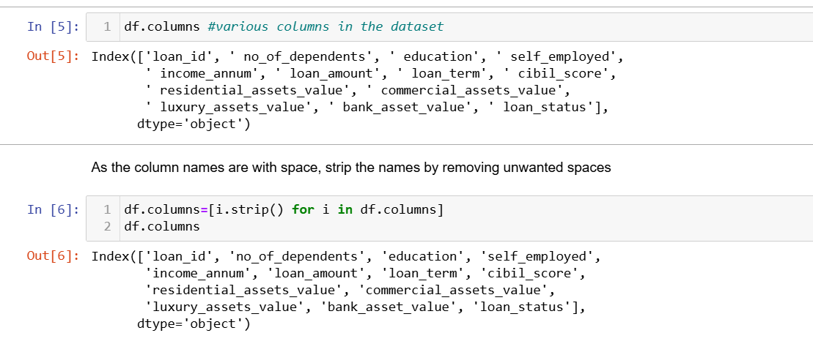
DATA CLEANING
Column name correction

Slide 8
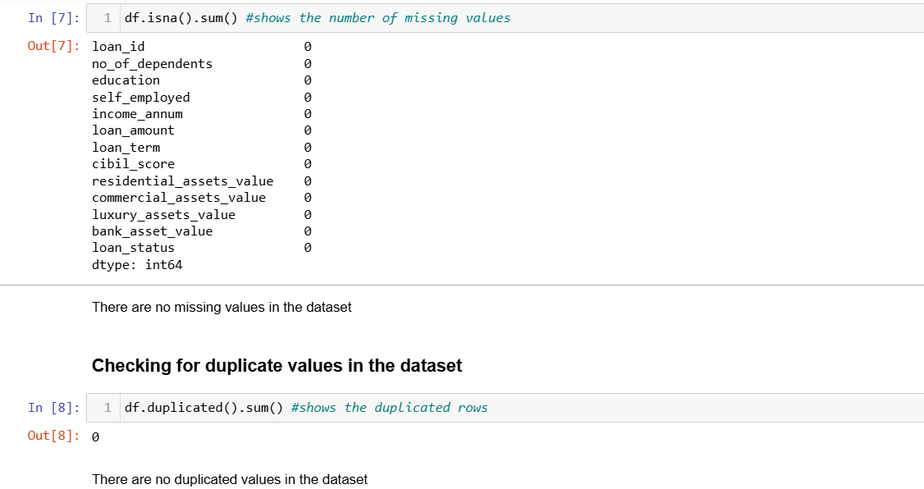
DATA CLEANING
Checking for Missing values and duplicate records

Slide 9
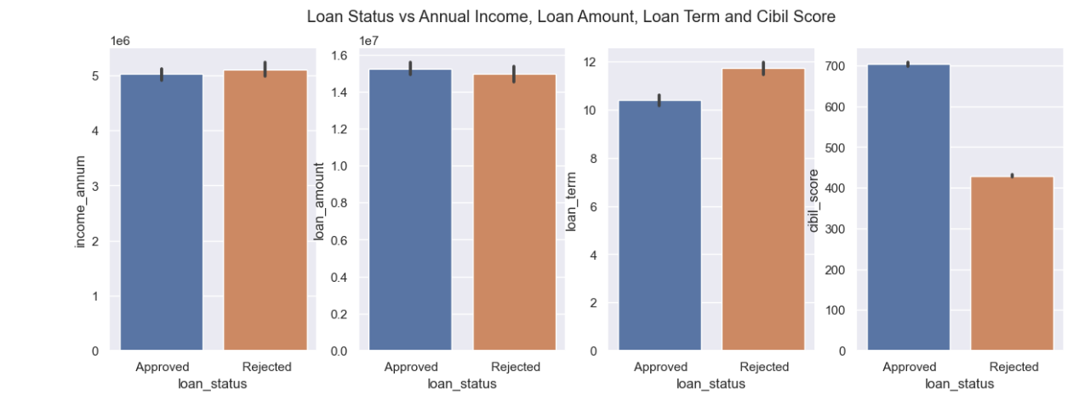
DATA VISUALISATION

Slide 10
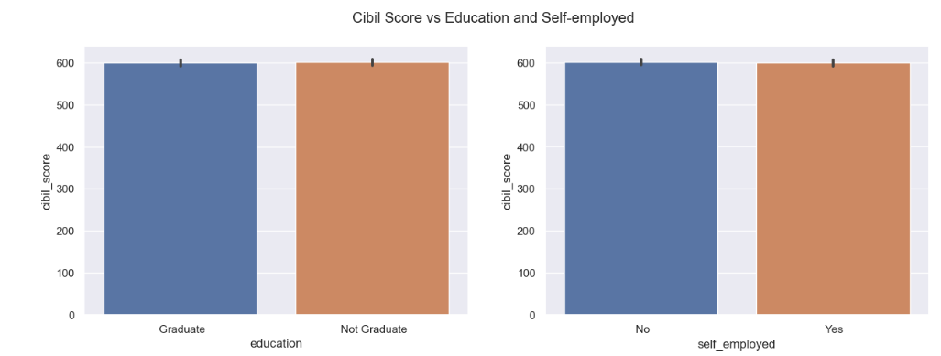
DATA VISUALISATION

Slide 11
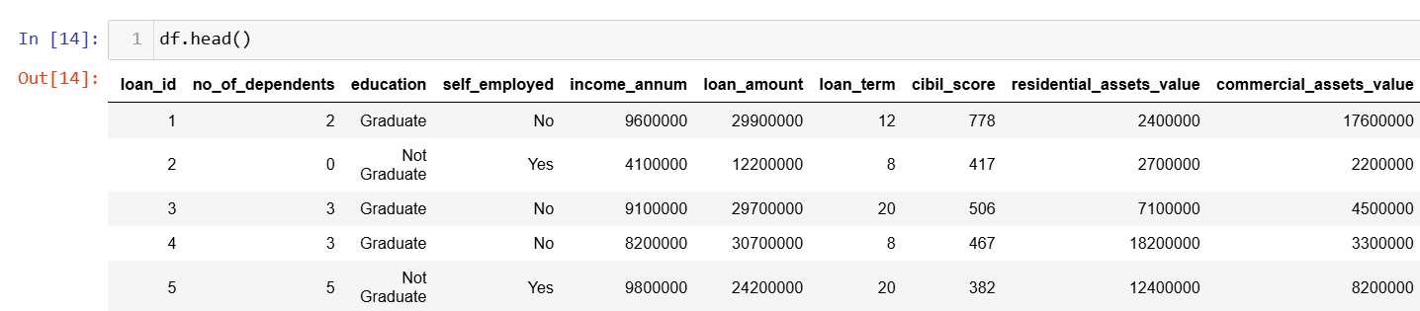
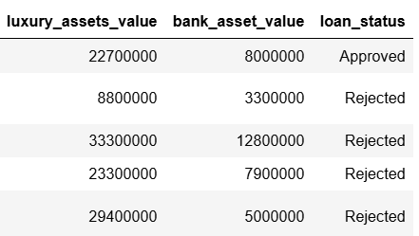

Slide 12
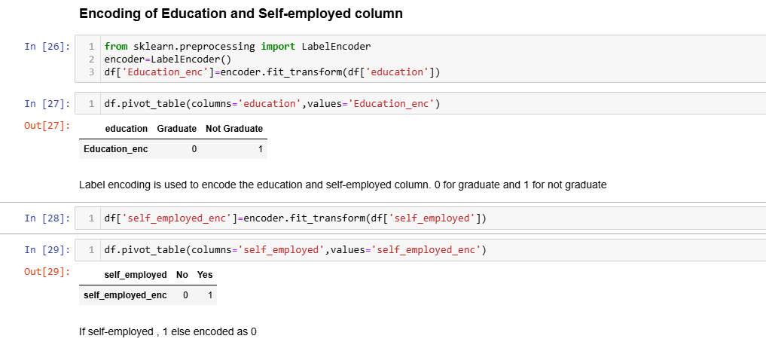
DATA PREPARATION
Encoding
Categorical columns – Loan Status, Education and Employment status are encoded into numerical columns
Label Encoding is used

Slide 13
DATA PREPARATION
Scaling
Using Standard Scaler, the values are standardized to avoid bias in the model

Slide 14
MODEL SELECTION
In the given problem Target variable is loan status - approved (1) or rejected (0)
It is a binary classification model.
Hence
Logistic Regression
KNN
SVM
Naïve Bayes
Decision Tree Classifier
Radom Forest Classifier can be used

Slide 15
TRAINING THE MODEL
Scikit-learn is used for building the model
Dataset is split into train and test data using train_test_split
Logistic and Decision tree Classifiers are built and model is trained with the train data using model.fit(train(x,y))
The built model is used for predicting the output of test data using model.predict(test(x))

Slide 16
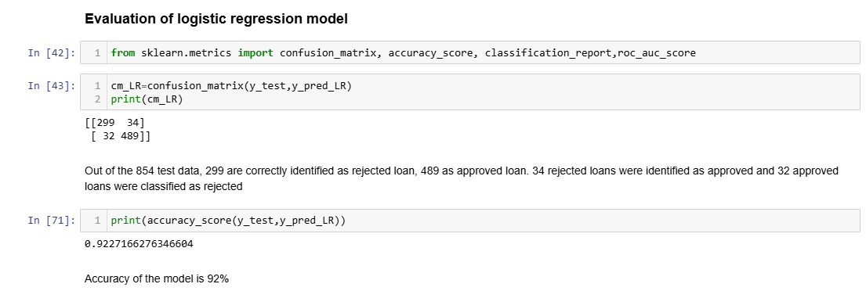
MODEL EVALUATION
Model is evaluated using
Confusion Matrix and Accuracy Score

Slide 17
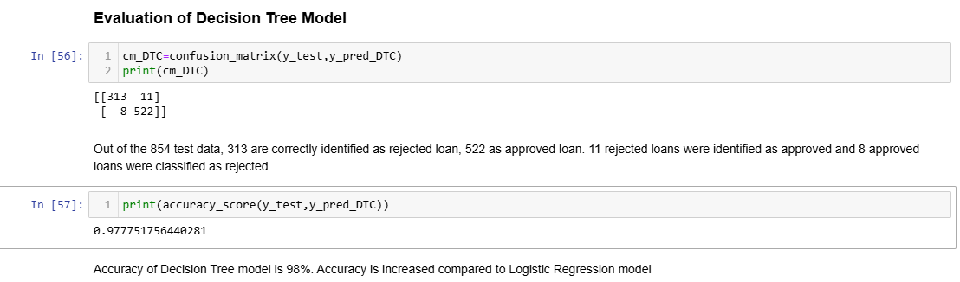
MODEL EVALUATION

Slide 18
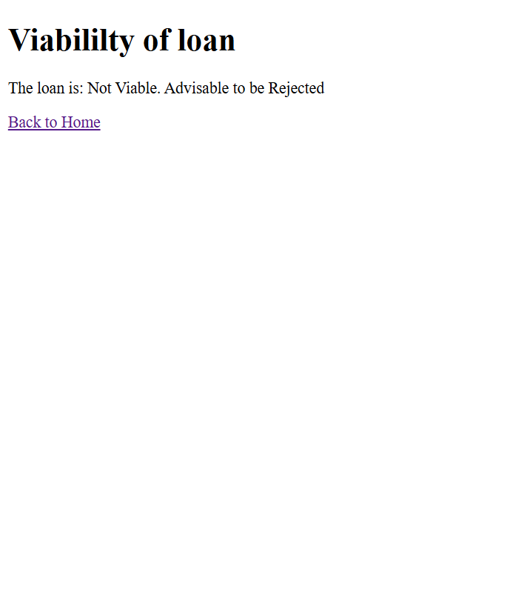
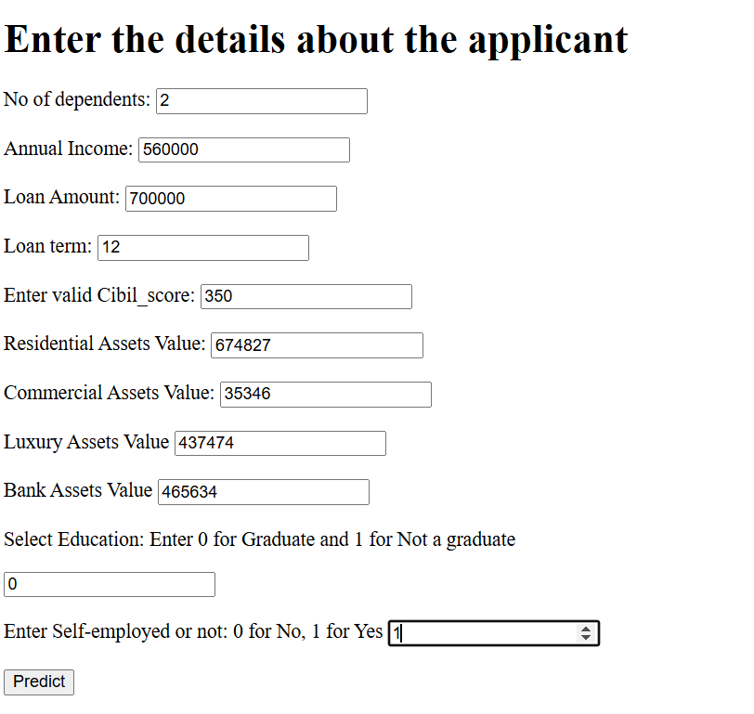
MODEL DEPLOYMENT USING FLASK

Slide 19
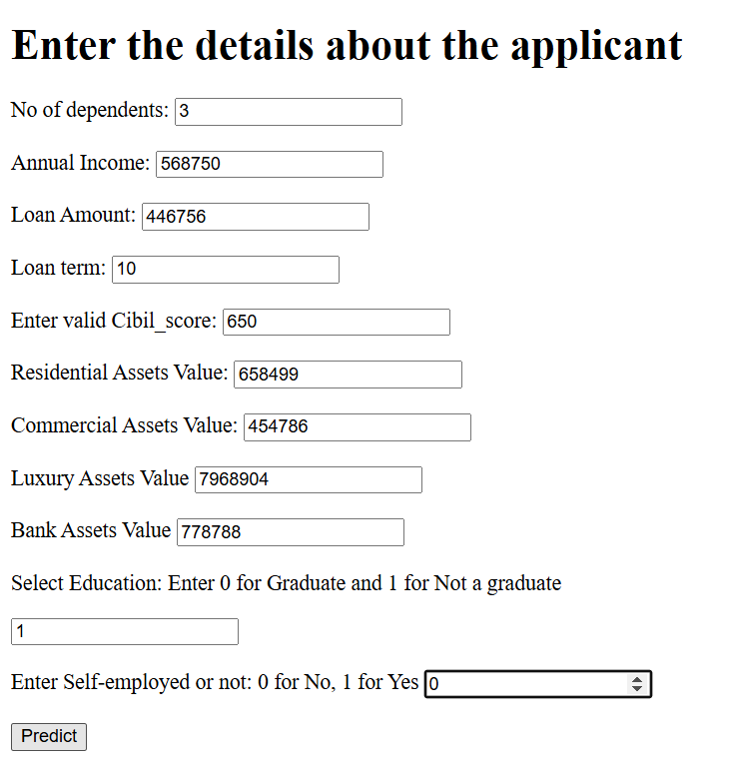
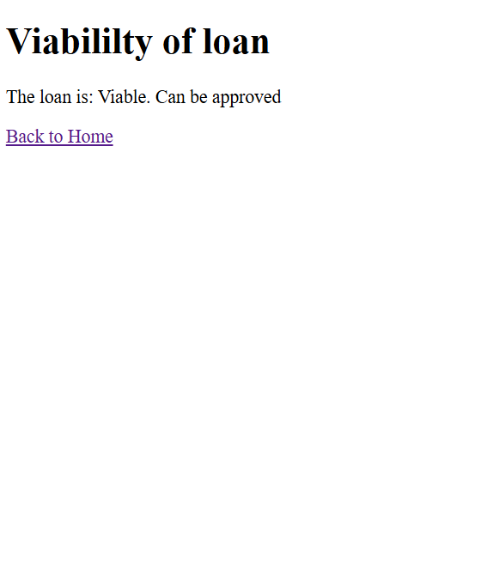
MODEL DEPLOYMENT USING FLASK

Slide 20
CHALLENGES AND SOLUTIONS
Logistic Regression – only for binary classification
Decision Tree Classifier – Issue – Overfitting
Can overcome using Random Forest Classifier

Slide 21
Conclusion
Decision Tree classifier performed well here with accuracy of 98%
Loan Prediction System – helps financial institutions to prevent default of loans
Future Enhancements:
Can increase the number of input features
Can try for other Classifiers and Comparison

Slide 22
Thank you

